Slide 1


Introduction to
Robotic Process Automation
REIMBURSEMENT
BOT
220701044
K BHARGAVI
Mrs. J. Jinu Sophia, M.E., (Ph.D)
Computer Science and Engineering

Slide 2
Abstract
The "Reimbursement Bot" is an automated solution designed to streamline invoice processing and reimbursement workflows. Using UiPath and OCR technologies, the bot extracts text from invoice PDFs, categorizes expenses, validates data against predefined policies, and generates structured Excel reports. This automation reduces manual intervention, minimizes errors, and ensures compliance with organizational standards. By improving efficiency and accuracy, the "Reimbursement Bot" provides a scalable and reliable system for managing high volumes of invoices.

Slide 3
Need for the Reimbursement Bot
Manual invoice processing is often slow, prone to errors, and requires significant human effort. With the increasing volume of invoices in organizations, there is a growing need for an automated, scalable solution that can handle diverse invoice formats efficiently. An automated system ensures compliance with expense policies, reduces operational costs, and minimizes the risk of inaccuracies.
Manual processing is error-prone and time-consuming.
Automation can handle high volumes of invoices effectively.
Ensures compliance with policies for accurate reimbursements.
Reduces operational costs and improves overall efficiency.
Provides faster turnaround time for reimbursements, improving user satisfaction.
Simplifies report generation, making it easier for administrators to review expenses.

Slide 4
Advantages
Automation of Repetitive Tasks: Eliminates manual effort in invoice processing, saving time and resources.
Improved Accuracy: Reduces errors by automating data extraction and validation, ensuring reliable results.
Compliance with Policies: Validates expenses against predefined rules, ensuring adherence to organizational guidelines.
Faster Reimbursement: Speeds up the processing of invoices and report generation, improving turnaround time.
Scalability and Adaptability: Handles large volumes of invoices and supports various formats efficiently.
Enhanced Reporting: Generates structured, easy-to-review Excel reports for better decision-making and auditing.

Slide 5
Literature Survey
Paper 1: "UiPath at Work - Automating the Invoice Process"
Advantage: Streamlines invoice management by automating repetitive tasks, reducing manual errors.
Disadvantage: High dependency on OCR performance; errors may occur with poorly scanned documents.
Paper 2: Expense Tracker
Advantage: Simplifies expense tracking by automating the categorization and organization of expenditures.
Disadvantage: Dependency on the accuracy of input data for reliable analysis.

Slide 6
Main Objective
The bot aims to streamline the reimbursement process by reducing manual intervention, minimizing errors, and ensuring faster, more efficient handling of invoices. Using OCR technology, it extracts expense details such as accommodation, travel, and food from invoice PDFs. The extracted data is then validated against predefined terms and conditions to ensure compliance and accuracy. Once validated, the data is organized into a structured Excel report, making it easier for administrators to review and approve reimbursements. This approach enhances efficiency, scalability, and accuracy, enabling organizations to handle workflows seamlessly, regardless of invoice complexity or volume. Additionally, the bot can adapt to changing requirements, ensuring long-term usability. It also enables businesses to save significant time and resources by automating repetitive and error-prone tasks.

Slide 7
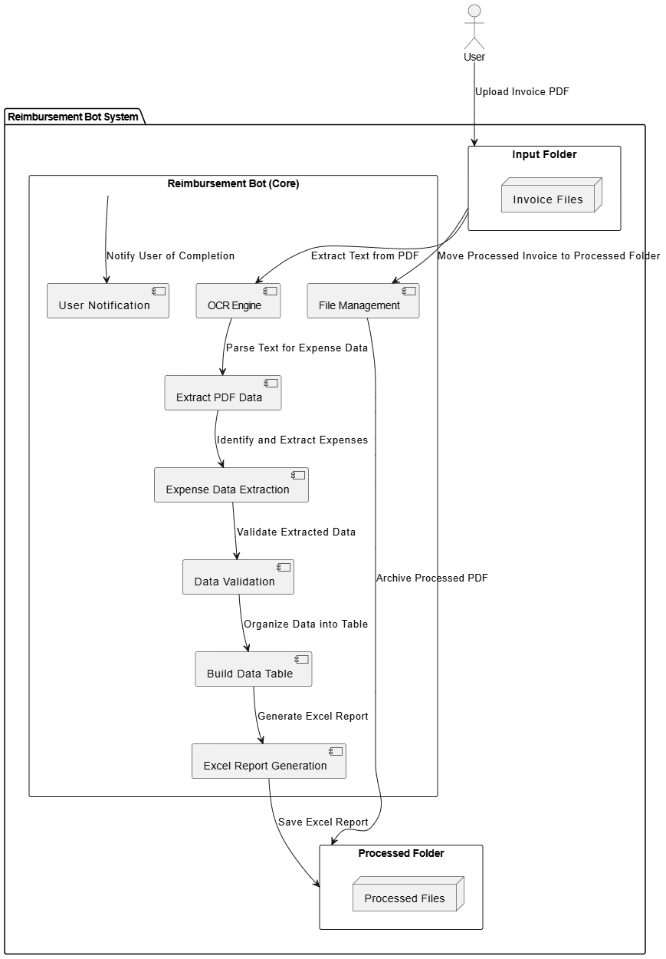
Architecture

Slide 8
System Requirements
Hardware Requirements:
Processor: 2.0 GHz or higher .
RAM: 8 GB or more for handling multiple invoices concurrently.
Storage: At least 10 GB
Network: Stable internet connection (for cloud-based OCR tools, updates, and file transfers).
Software Requirements:
Operating System: Windows 7 or higher (64-bit recommended).
UiPath Studio: Latest stable version of UiPath Studio for developing, testing, and running workflows.
OCR Tools: Integration with OCR tools like Google Cloud Vision, ABBYY OCR, or UiPath's native OCR engine for text extraction.
Microsoft Excel: Excel 2016 or later for generating and formatting reports via UiPath Excel Activities.

Slide 9
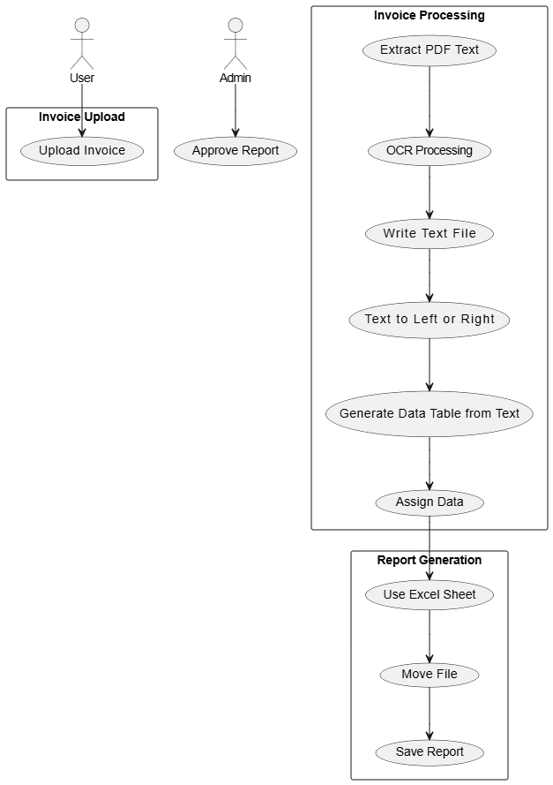
Functional Description
Model1: Extract PDF Text: This module uses the OCR engine to extract text from scanned or image-based invoices. It converts the PDF content into raw text, enabling further processing. It's essential for working with non-searchable PDF invoices.
Model2: Generate Data Table from Text: This activity converts the extracted text into a structured data table format. It categorizes the data (like accommodation, travel, and food expenses) to make it easier to store and analyze in subsequent steps (e.g., in Excel).

Slide 10
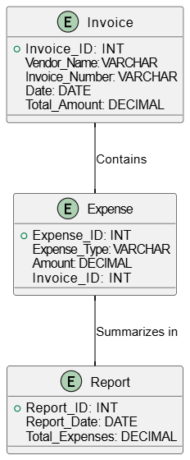
Table Design

Slide 11
Process Design
Main Process
Invoice Upload: User uploads invoice PDFs to the system, triggering the processing flow.
OCR Processing: OCR technology extracts readable text from scanned or image-based invoices.
Data Extraction: Extracts key expense data (e.g., accommodation, travel, food) from the invoice text.
Validation: Validates the extracted data against predefined reimbursement policies for compliance.
Report Generation: Generates a structured Excel report with validated expense data.
Sub-Processes
File Management: Moves processed invoices to the "Processed Folder" and stores the generated report.
Notification Handling: Sends notifications to the user upon completion of invoice processing and report generation.

Slide 12
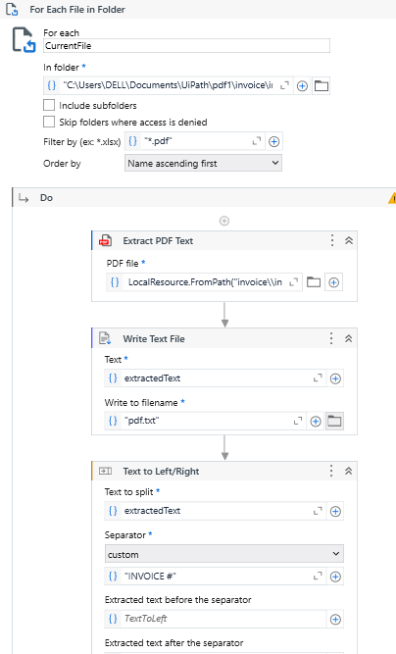
Implementation
Model1 : Extract the key elements
It utilizes the Extract PDF Activity to extract the raw text from the input PDF. The Text to Right or Left Activity is then employed to identify and extract key elements, such as accommodation, travel, and food expenses, from the text based on their position relative to predefined markers. This method ensures efficient and accurate data extraction for further processing.

Slide 13
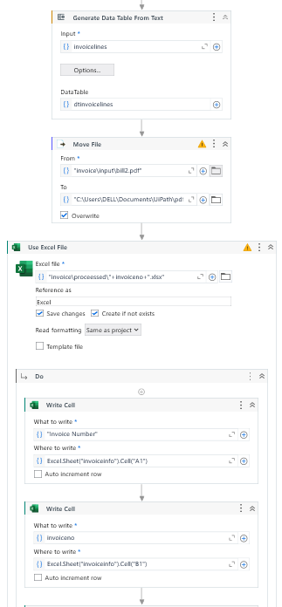
Implementation
Model 2 : Generate the excel sheet from the data table
This model uses the Build Data Table Activity to structure the extracted data into a table format, making it easier to manage. The Use Excel Sheet Activity is then applied to write the organized data into a final Excel report, ensuring the data is properly formatted .

Slide 14
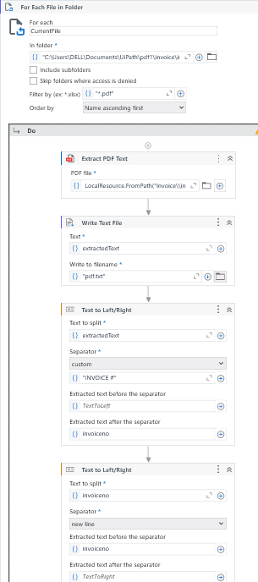
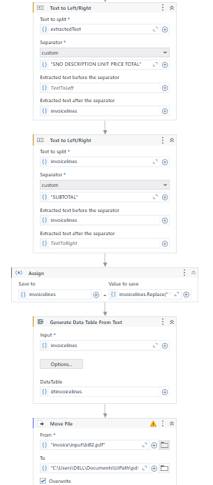
Implementation

Slide 15
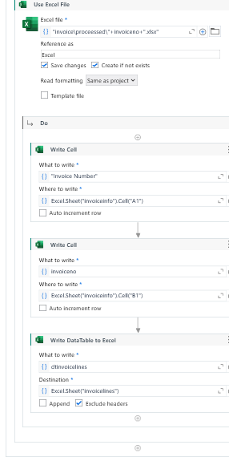
Implementation

Slide 16
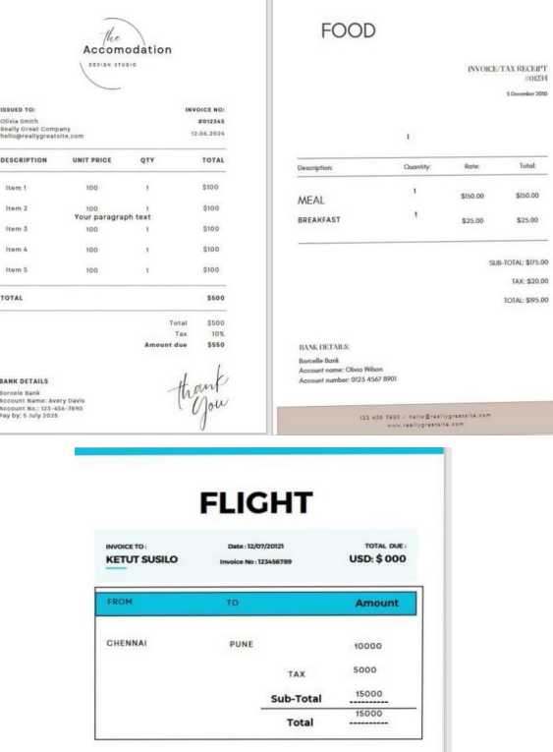
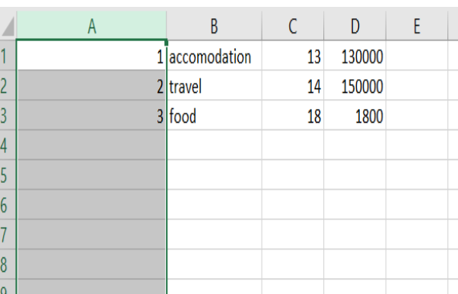
Testing
The testing phase ensures the bot's functionality by verifying accurate data extraction, proper validation, and correct Excel report generation. It also ensures that the bot handles different invoice formats and flags errors, confirming the system's reliability and readiness for deployment.

Slide 17
Conclusions
The "Reimbursement Bot" automates the invoice processing workflow, addressing inefficiencies in manual reimbursement tasks. By utilizing UiPath and OCR technologies, it extracts, validates, and organizes expense data with accuracy and compliance. The bot generates structured Excel reports, reducing manual effort, minimizing errors, and accelerating processing. This scalable and adaptable solution enhances efficiency, transparency, and cost-effectiveness, modernizing expense management for organizations.

Slide 18
Future Enhancement
AI-Powered Data Validation: Implement machine learning models to enhance the accuracy of expense validation and compliance checks.
ERP Integration: Seamlessly connect the bot with enterprise systems like SAP or Oracle for automated data synchronization.
Multi-Language OCR Support: Enable processing of invoices in multiple languages to cater to global operations.
Mobile App Integration: Create a mobile-friendly interface for users to upload invoices and receive notifications.
Real-Time Analytics: Develop dashboards to provide real-time insights into processed invoices and expense trends.

Slide 19
References
https://www.researchgate.net/publication/373144276_Expense_Tracker
https://www.researchgate.net/publication/381850671_INTELLIGENT_AUTOMATION_IN_ACCOUNTING_AND_FINANCIAL_REPORTING
https://www.uipath.com/blog/product-and-updates/uipath-at-workautomating-the-invoice-process
https://ieeeaps.org/membership/ieee-expense-policy
https://www.ieee-ras.org/about-ras/voluntee

Slide 20
Thank You

